Slide 1
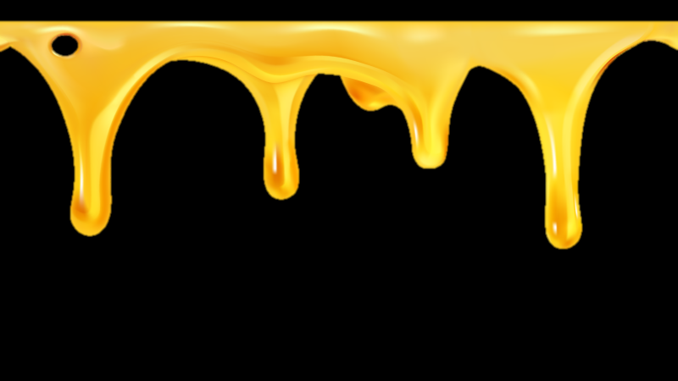
To What Extent is Florida's Bee Shortage a Problem
Dylan Martin #7336

Slide 2
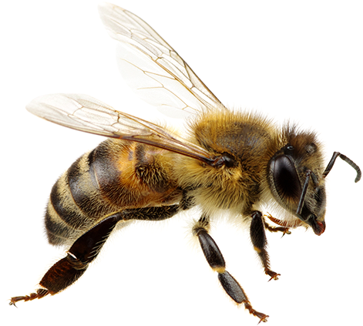
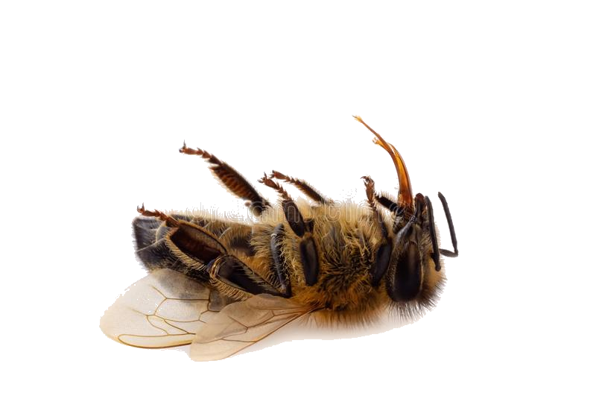
BUZZ
(Kosolovskyy, 2020)
(NICEPNG, 2019)
NOTHING HONEY-SWEET!

Slide 3
Perspectives
Environmental
(Ecology)
Political
Regulation/
Legislation
Economic
(Business)
Avarice

Slide 4
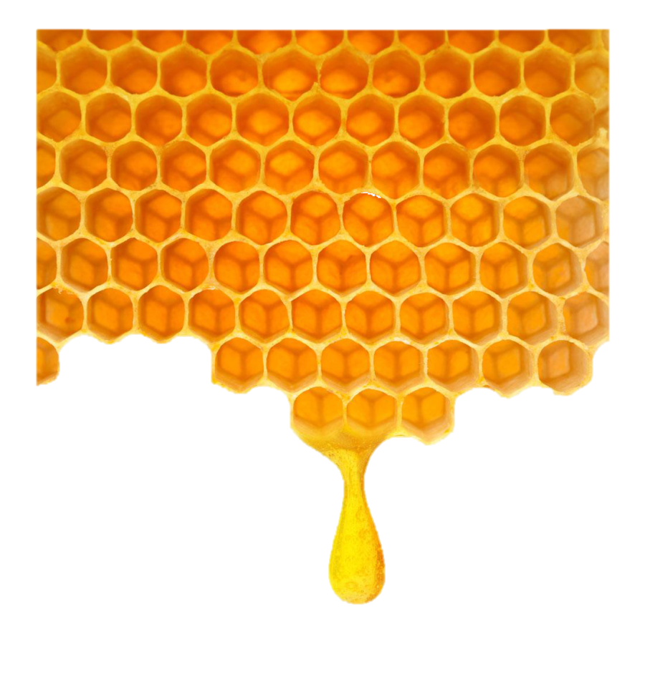
Thesis
Bee shortages are a huge problem politically due to a lack of regulation and threatening government actions
huge

Slide 5
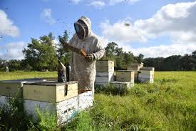
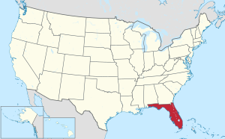
Local Significance
(Kimel, 2020)
(City-data,com, 2019)

Slide 6
Reasons
Allowance of threats to bees
Absence of Regulation and Legislation
Passivity
Greed
Problem

Slide 7
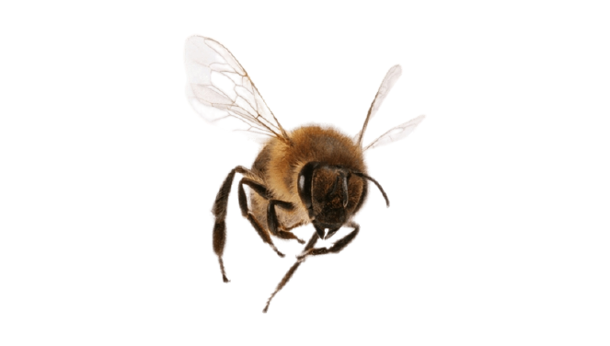
Regulation & Legislation
The Bureau of Plant & Apiary Inspection of the FDACS
(Kimel, 2020)
(Kosolovskyy, 2020)

Slide 8
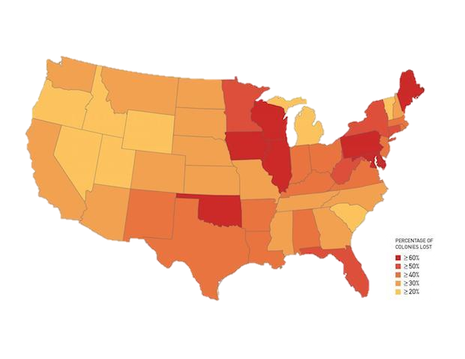
Lack of Information
Colony Collapse Disorder
(Casey, 2015)

Slide 9
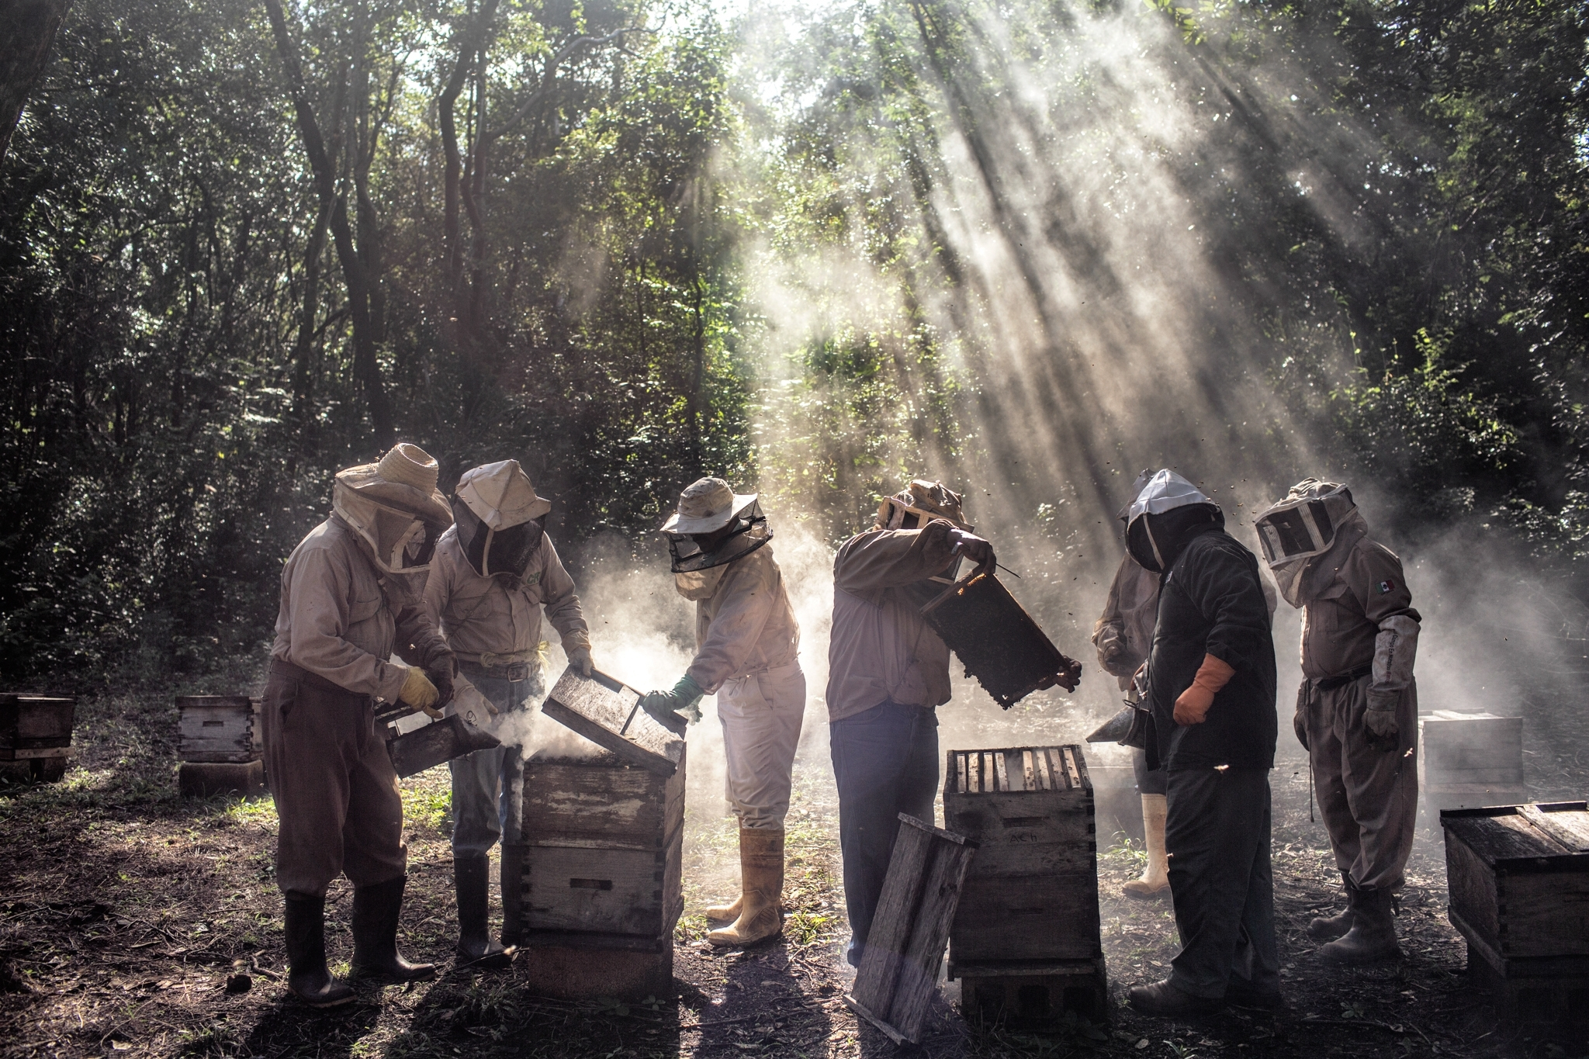
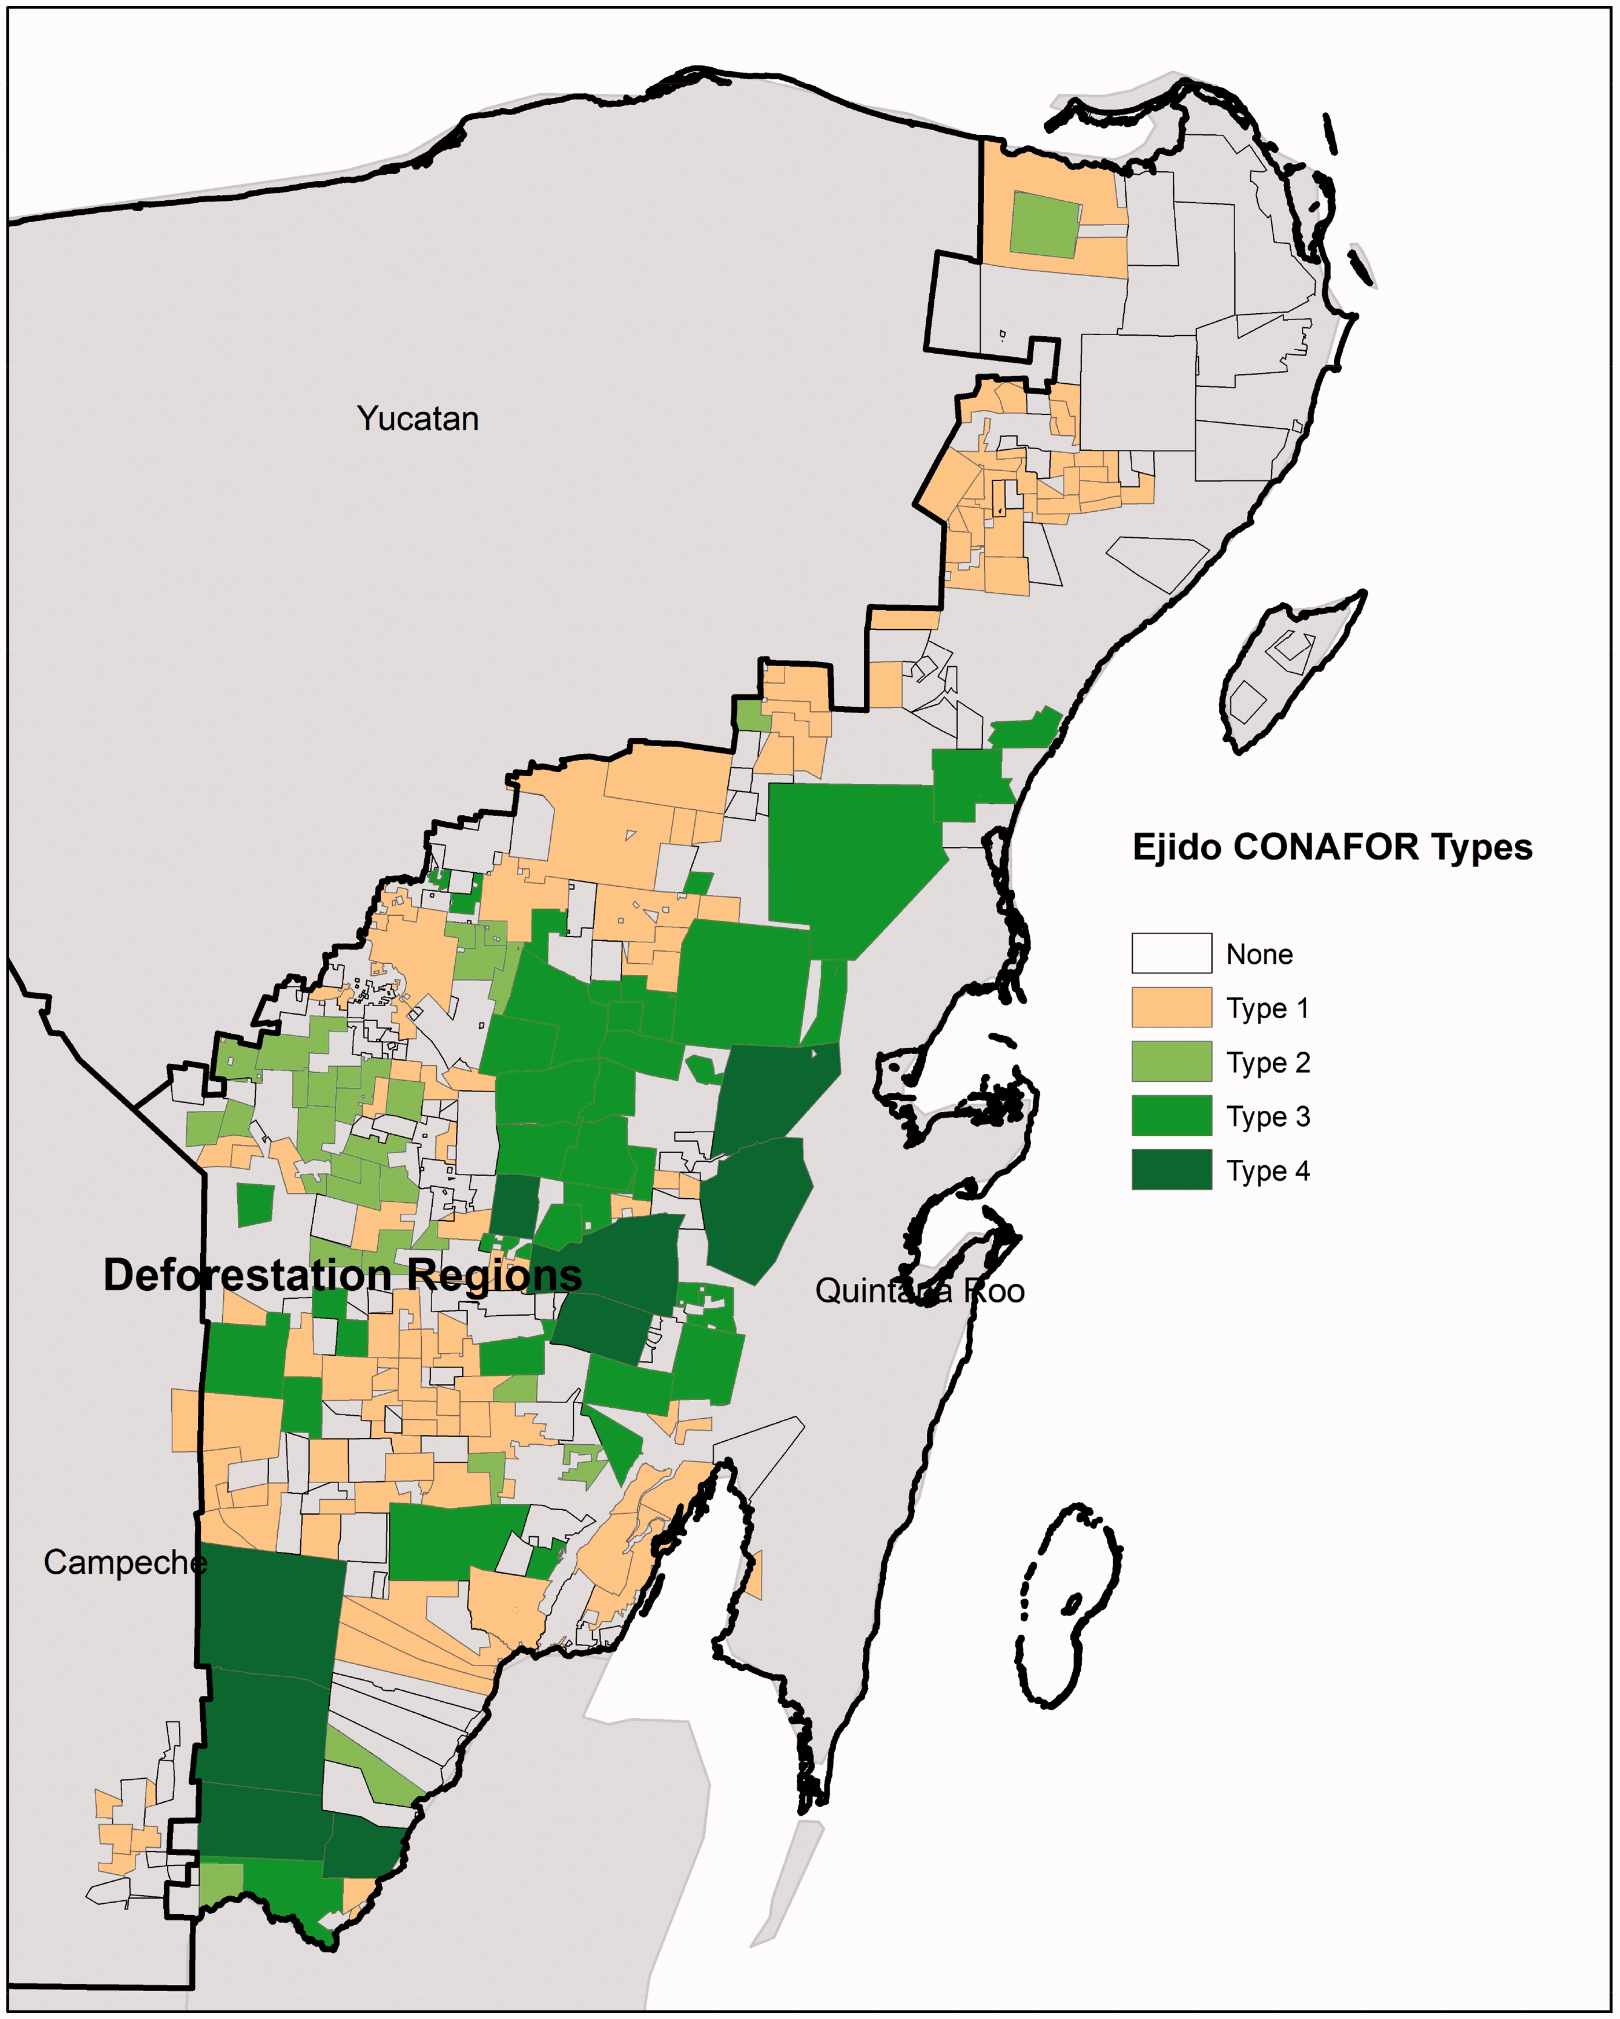
Threat Allowance
Mexican Government — Yucatan Peninsula Deforestation
Ellis, 2020
Strochlic, 2019

Slide 10
Greed
Russian Honeybee Decline
(Landportal, 2021)

Slide 11
Recap
Governments
Lack of information, legislation, regulation
Allowing threats
TOO LATE

Slide 12
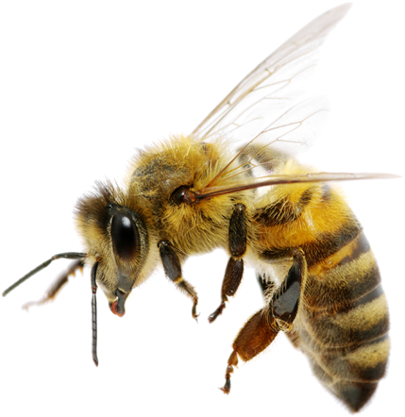
Transition to Solutions
(StickPNG, 2021)
(Pngimg, 2020)

Slide 13
Solutions
City Regulation
Pesticide Legislation
Reducing Threat
Informed Public
Fix

Slide 14
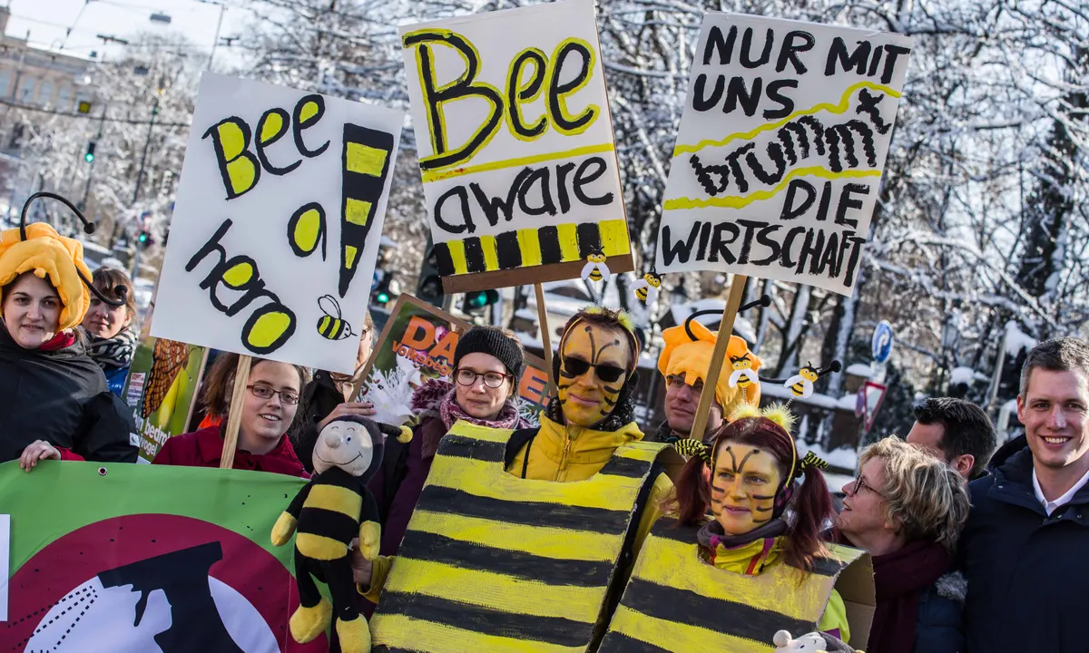
Global Solution
German legislation
Connolly, 2019

Slide 15
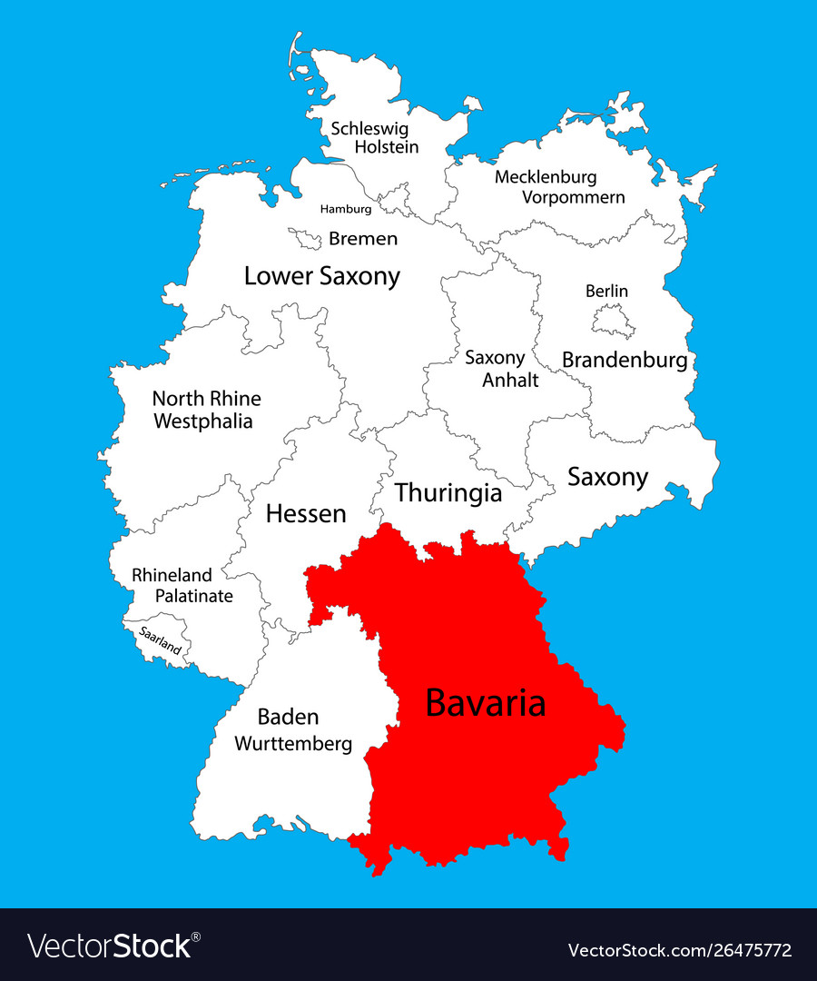
Global Solution
Bavaria specifically
(CleaningCommunity, 2021)
(VectorStock, 2021)

Slide 16
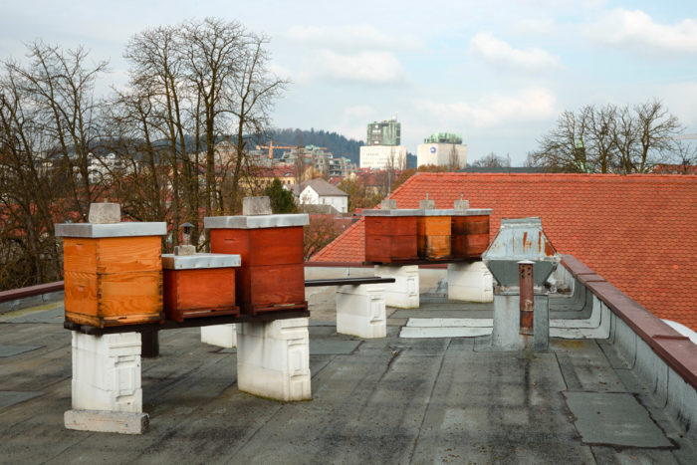
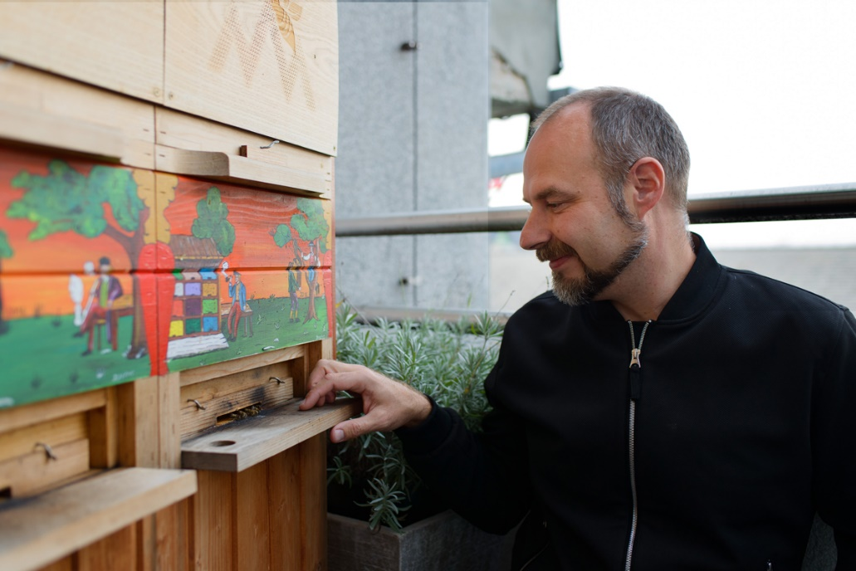
Local Solution
Regulating on a city level (Ljubljana, Slovenia)
(Hruby, 2019)
(Hruby, 2019)

Slide 17
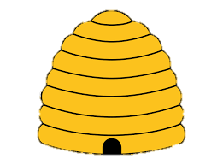
Hive Mind
(Vexels, 2021)

Slide 18
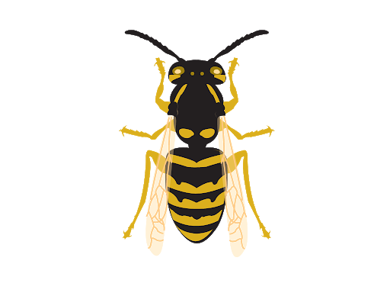
School System Implementation
(StickPNG, 2021)
(Vexels, 2021)

Slide 19
Hive Mind through School Implementation
Bee shortage problem
Passivity of governments
Allowance of threats
Regulating cities
Introducing new legislation

Slide 20
Final Thought Why does it all matter?
(Unsplash, 2021)

Slide 21
References
https://www.dreamstime.com/macro-close-up-dead-honey-bee-white-background-macro-close-up-dead-honey-bee-white-background-image123292810
https://www.nicepng.com/ourpic/u2a9o0i1o0t4u2i1_flying-bee-png-flying-honey-bee-png/
http://www.city-data.com/city/Sarasota-Florida.html
https://www.heraldtribune.com/story/business/2020/11/30/sarasota-manatee-beekeepers-keep-honey-flowing/6372336002/
https://www.cbsnews.com/news/40-percent-of-u-s-bee-colonies-died-in-past-year/
https://www.nationalgeographic.com/environment/2019/04/unlikely-feud-beekeepers-mennonites-simmers-mexico/
https://bioone.org/journals/Tropical-Conservation-Science/volume-10/issue-1/1940082917697259/Deforestation-Processes-in-the-State-of-Quintana-Roo-Mexico/10.1177/1940082917697259.full
https://data.landportal.info/organization/government-russia

Slide 22
References cont.
(n.d.). Retrieved February 24, 2021, from https://www.google.com/search?q=bee%2Btransparent%2Bbackground&tbm=isch&ved=2ahUKEwjOw6qpyP3uAhXR1lkKHbB7AA0Q2-cCegQIABAA&oq=bee%2Btransparent%2Bbackground&gs_lcp=CgNpbWcQAzIECAAQQzICCAAyAggAMgIIADICCAAyAggAMgIIADICCAAyAggAMgIIAFDtpgJY7aYCYI6tAmgAcAB4AIABW4gBW5IBATGYAQCgAQGqAQtnd3Mtd2l6LWltZ8ABAQ&sclient=img&ei=LK0zYM79F9Gt5wKw94Fo&bih=578&biw=1263&rlz=1C1GCEB_enUS918US918&hl=en-US&safe=active&ssui=on#imgrc=Keq_fu2lBdZ_5M​
​
Bavaria campaigners abuzz as Bees Petition forces farming changes. (2019, February 14). Retrieved February 24, 2021, from https://www.theguardian.com/world/2019/feb/14/bavaria-campaigners-abuzz-as-bees-petition-forces-farming-changes​
​
Bee png image with transparent background. (n.d.). Retrieved February 24, 2021, from https://pngimg.com/image/74690​
​
GP 5 gas Mask transparent PNG - StickPNG. (n.d.). Retrieved February 24, 2021, from https://www.stickpng.com/img/objects/gas-masks/gp-5-gas-mask​
​
Mirabilia. (n.d.). Honey bee Drawing PNG , free transparent Clipart - ClipartKey. Retrieved February 24, 2021, from https://www.clipartkey.com/view/hibRmo_honey-bee-drawing-png/​
​
Modern-high-school-building-illustration. (n.d.). Retrieved February 24, 2021, from https://www.vexels.com/png-svg/preview/152831/modern-high-school-building-illustration​
​
Referendum in Bavaria for bees. (2019, March 10). Retrieved February 24, 2021, from https://www.cleaningcommunity.net/referendum-in-bavaria-for-bees/​
​
Wilson, A. (2020, February 24). Photo by Alyssia Wilson on Unsplash. Retrieved February 24, 2021, from https://unsplash.com/photos/8O0_aFy72KY

